Slide 1
Root Locus, Compensators, PID design, Bode Plot

Slide 2
Outline
Introduction
Angle and Magnitude Condition
Construction of Root Loci
Examples

Slide 3
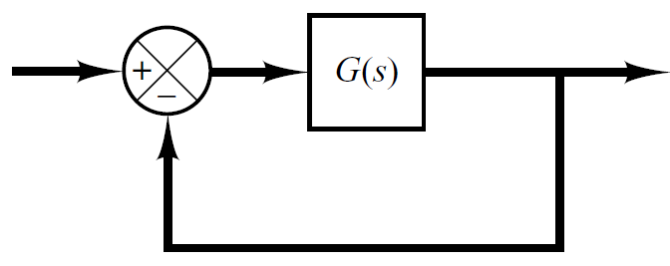
Introduction
Consider a unity feedback control system shown below.
The open loop transfer function G(s) of the system is
And the closed transfer function is

Slide 4
Introduction
Location of closed loop Pole for different values of K (remember K>0).
K | Pole
0.5 | -1.5
1 | -2
2 | -3
3 | -4
5 | -6
10 | -11
15 | -16

Slide 5
What is Root Locus?
The root locus is the path of the roots of the characteristic equation traced out in the s-plane as a system parameter varies from zero to infinity.

Slide 6
How to Sketch root locus?
One way is to compute the roots of the characteristic equation for all possible values of K.
K | Pole
0.5 | -1.5
1 | -2
2 | -3
3 | -4
5 | -6
10 | -11
15 | -16

Slide 7
How to Sketch root locus?
Computing the roots for all values of K might be tedious for higher order systems.
K | Pole
0.5 | ?
1 | ?
2 | ?
3 | ?
5 | ?
10 | ?
15 | ?

Slide 8

Construction of Root Loci
Finding the roots of the characteristic equation of degree higher than 3 is laborious and will need computer solution.
A simple method for finding the roots of the characteristic equation has been developed by W. R. Evans and used extensively in control engineering.
This method, called the root-locus method, is one in which the roots of the characteristic equation are plotted for all values of a system parameter.

Slide 9
Construction of Root Loci
The roots corresponding to a particular value of this parameter can then be located on the resulting graph.
By using the root-locus method the designer can predict the effects on the location of the closed-loop poles of varying the gain value or adding open-loop poles and/or open-loop zeros.

Slide 10
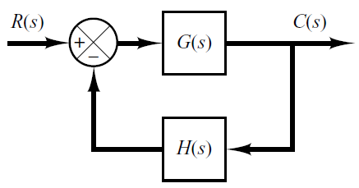
Angle & Magnitude Conditions
In constructing the root loci angle and magnitude conditions are important.
Consider the system shown in following figure.
The closed loop transfer function is

Slide 11
Construction of Root Loci
The characteristic equation is obtained by setting the denominator polynomial equal to zero.
Or
Since G(s)H(s) is a complex quantity it can be split into angle and magnitude part.

Slide 12
Angle & Magnitude Conditions
The angle of G(s)H(s)=-1 is
Where k=1,2,3…
The magnitude of G(s)H(s)=-1 is

Slide 13
Angle & Magnitude Conditions
Angle Condition
Magnitude Condition
The values of s that fulfill both the angle and magnitude conditions are the roots of the characteristic equation, or the closed-loop poles.

Slide 24
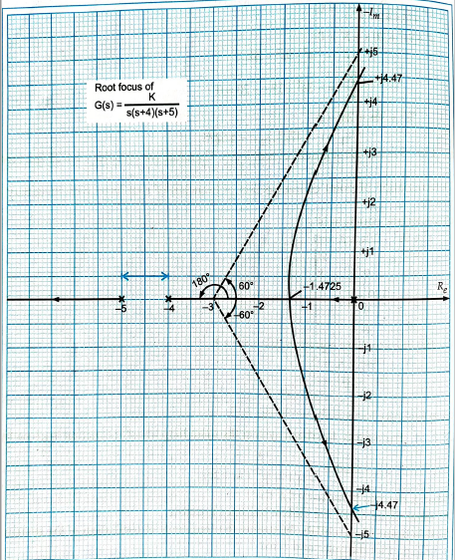

Slide 25
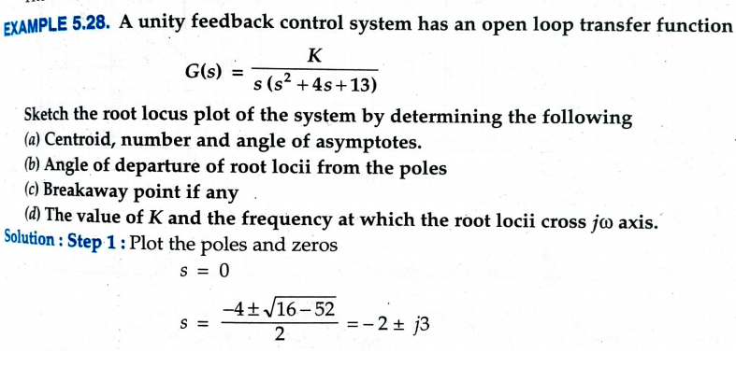

Slide 26
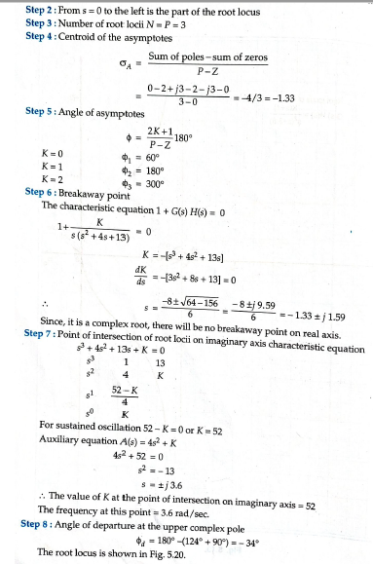

Slide 27
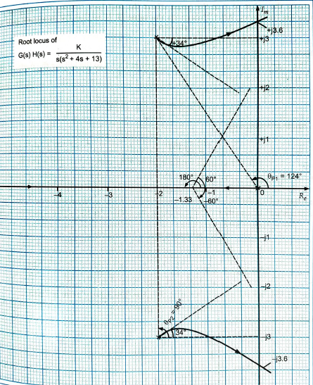

Slide 28
Compensators
Why do we need compensators?
What are the most common types of compensators in control systems?
What is the effect of the addition of a pole and a zero to a root locus?
How to design a compensator?

Slide 29
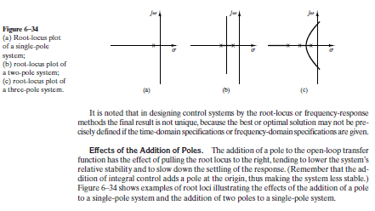

Slide 30
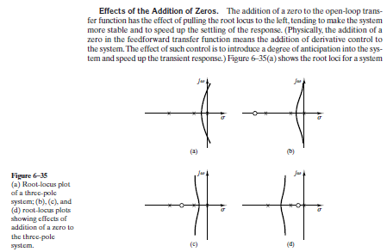

Slide 31
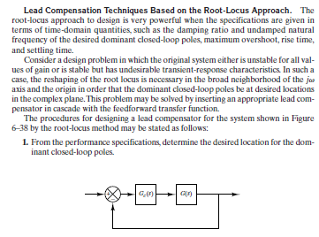

Slide 32
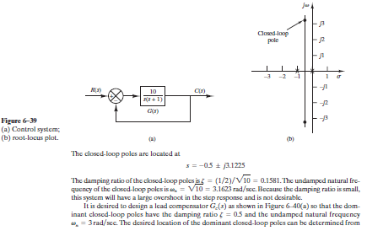

Slide 33
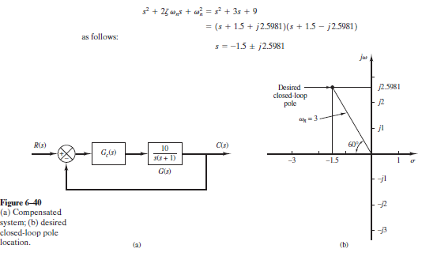

Slide 34
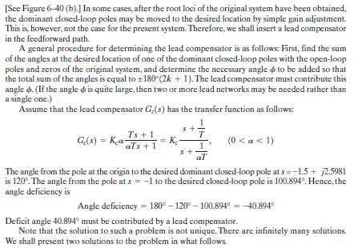

Slide 35
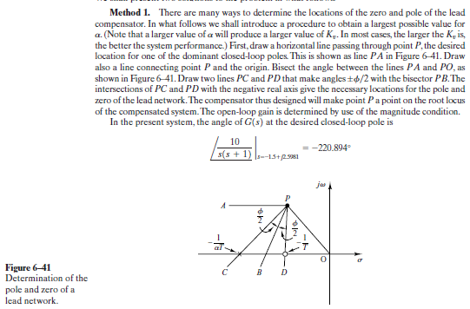

Slide 36
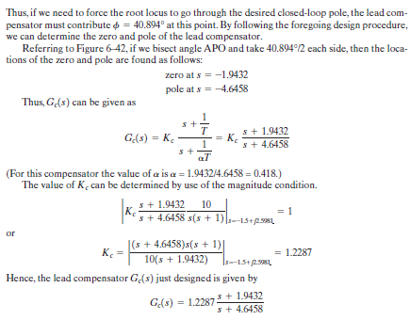

Slide 37
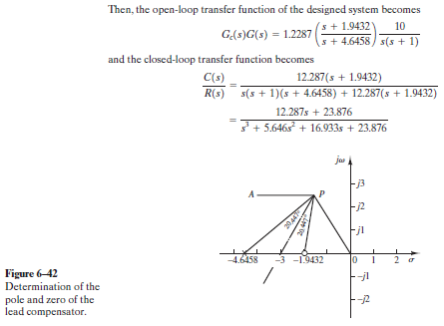

Slide 38
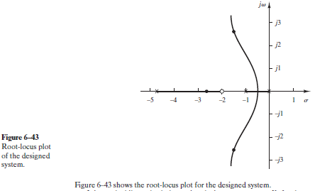

Slide 39
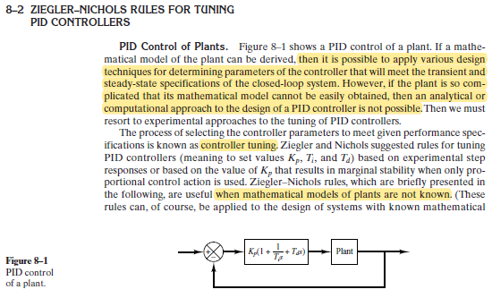
PID Controller Design

Slide 40
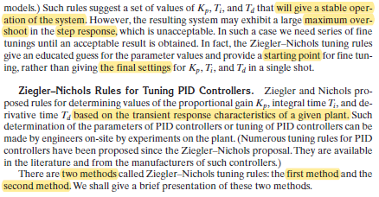

Slide 41
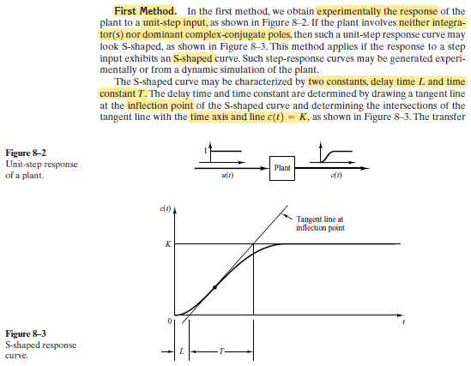

Slide 42
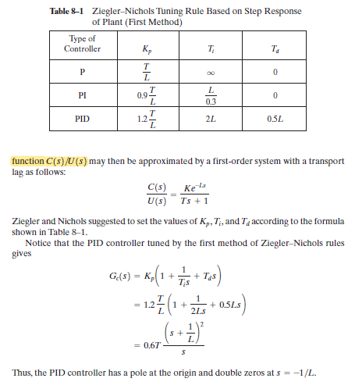

Slide 43
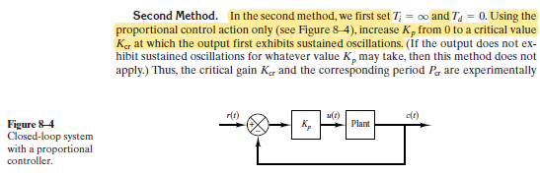
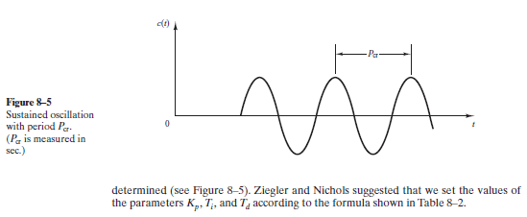

Slide 44
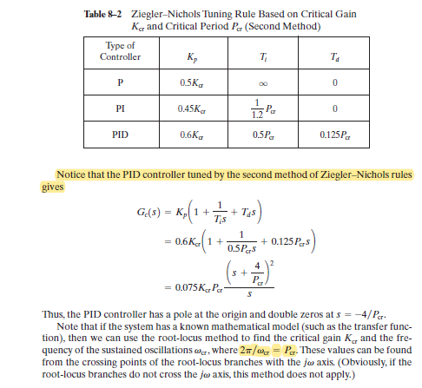

Slide 45
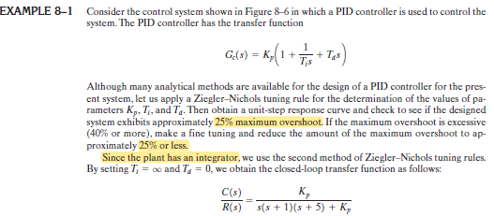
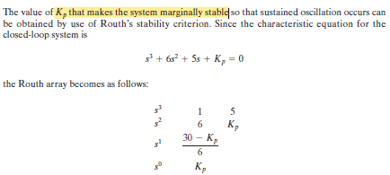

Slide 46


Slide 47
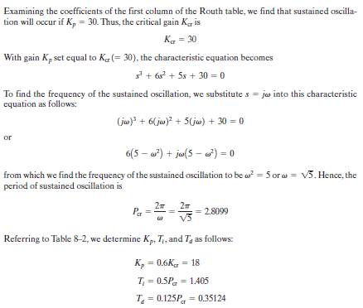

Slide 48
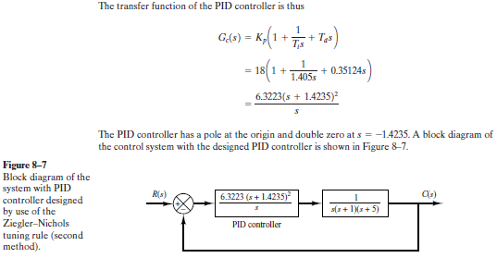

Slide 49
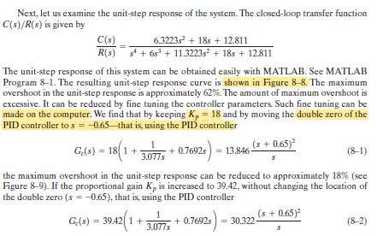

Slide 50
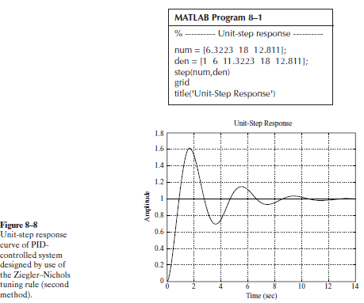

Slide 51
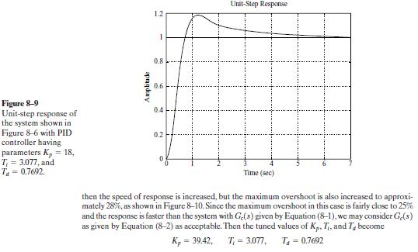

Slide 52
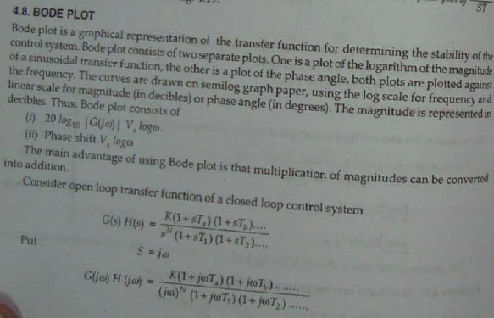
Bode Plot

Slide 53
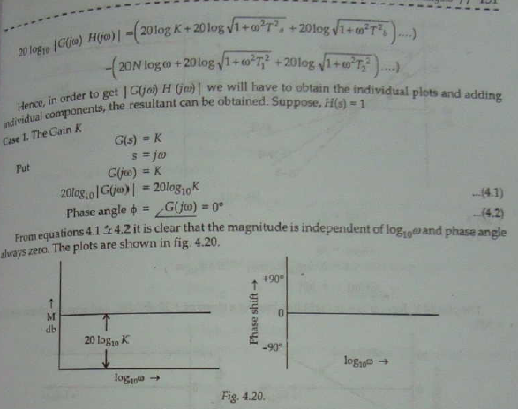

Slide 55
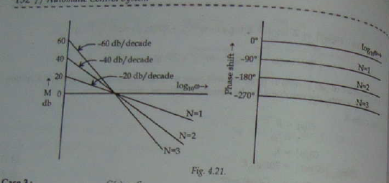

Slide 58
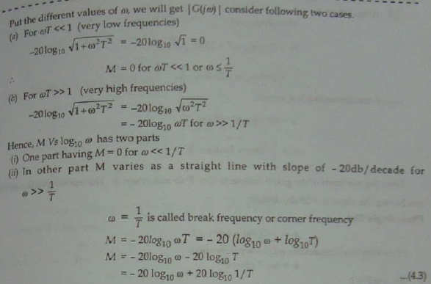

Slide 59
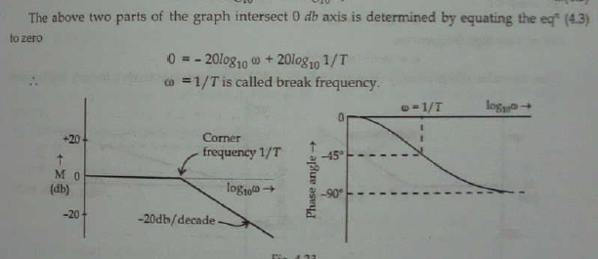

Slide 61
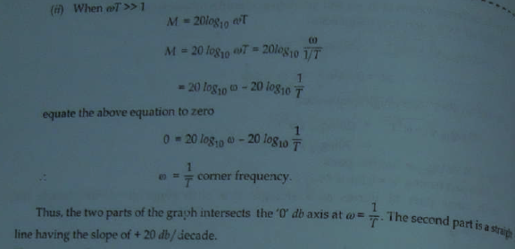

Slide 74
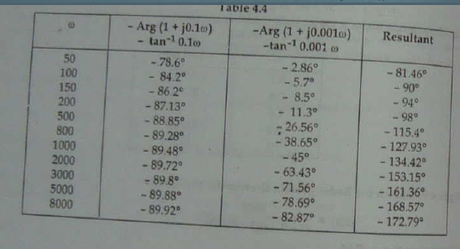

Slide 75
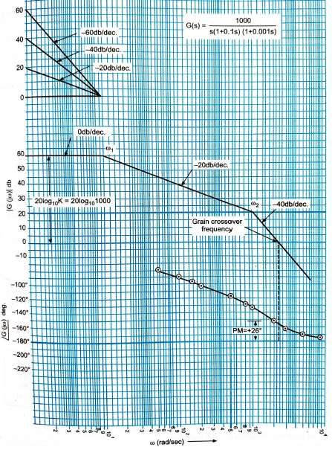

Slide 78
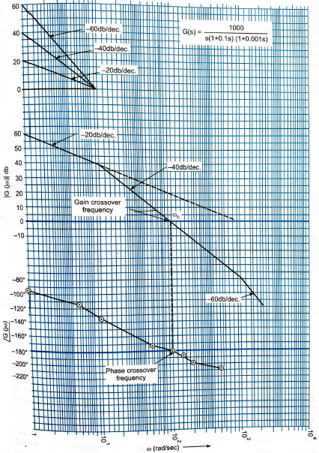

Slide 80
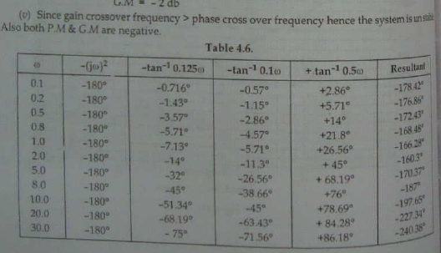

Slide 81
